Slide 1
Basic database development cycle
Write documentation (use cases, etc..)‏
Determine hardware/software
Determine which tables/relationship (UML schemas)‏
Test database
Use it!

Slide 2
documentation
We have to collect examples of how are we going to use the database (use cases):
  If we want to store the results in the same database, and which ones
  Which statistics we want to calculate

Slide 3
Hardware/Software requirements
HGDP data: ~600 individuals, ~536.000 SNPs, → ~10^8 rows
At least 10 or 20 GB of disk space
Regular backups are also needed
DBMS Software: Postgres or mysql

Slide 4
Database Schema
Tables needed:
  SNPs (marker)‏
  Genotypes
  Individuals
  Populations
Relationships:
  Genotypes to SNPs and Individuals

Slide 5
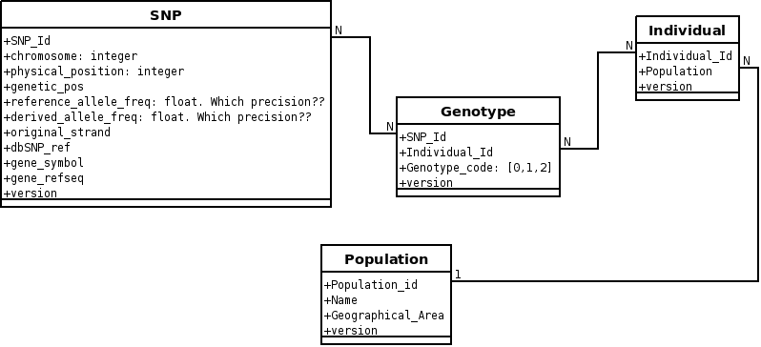
Database schema

Slide 6
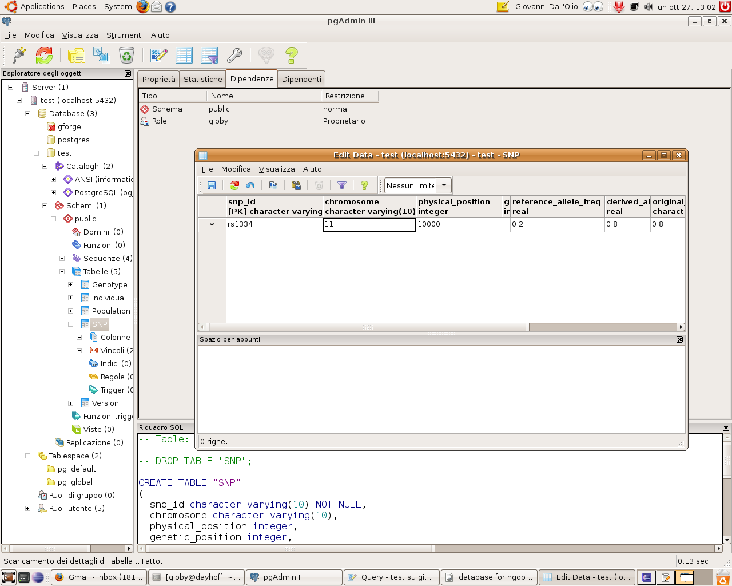
Testing database
Uploading big quantities of data and see how it performs
This phase takes time, too

Slide 7
How to use it
Direct SQL:
  Select *
  from genotypes
  where....
ORM modules:
  >>> db_connection = sqlalchemy.metadata.connect('postgres', localhost, username, password)
  >>> db_connection.select('Individuals').filter_by('name == Einstein')‏

